Slide 1
Employee Attrition and Salary Prediction
Puri Rudick
02/28/2021
Notes:
Photo by freepik

Slide 2
Agenda
01.
Data Overview
02.
Top Three Factors for Attrition
03.
Attrition Prediction Using kNN Technique
04.
Salary Prediction Using Multiple Linear Regression
05.
Trends for Specific Job Roles

Slide 3
Data Overview
The dataset contains 870 observations (employees) with 36 variables
140 observations were identified as ‘Attrition’ while another 730 observations were identified as ’No Attrition’
The dataset has no missing values

Slide 4
Attrition - Top Three Factors
OT
Monthly Income
Job Involvement
Overtime
Min $1,081
Average $6,930
Max $19,999
1 - Low
2 - Medium
3 - High
4 - Very High
Categorized with ‘Yes’ and ‘No’
Overtime negotiable refers to Non-Exempt Employee

Slide 5
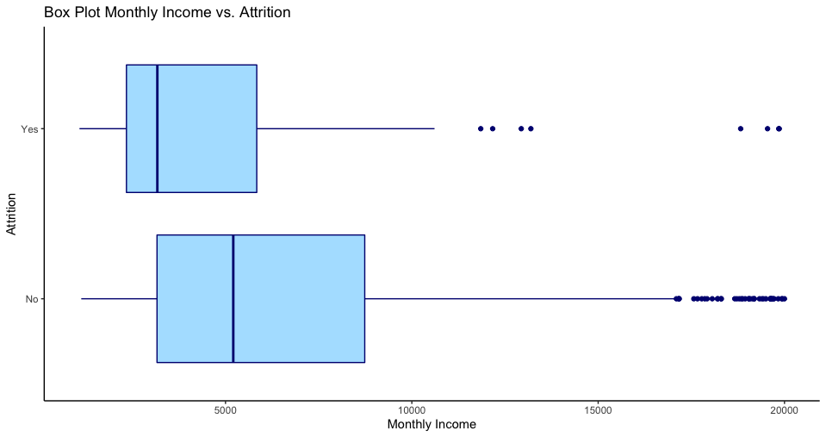
Monthly Income
On average, the employees who decided to leave had significant lower monthly income
Median ‘Attrition’ = $3,171
Median ‘No Attrition’ = $5,208
This suggests that employees with lower monthly income tend to turnover more than the employees with higher income

Slide 6
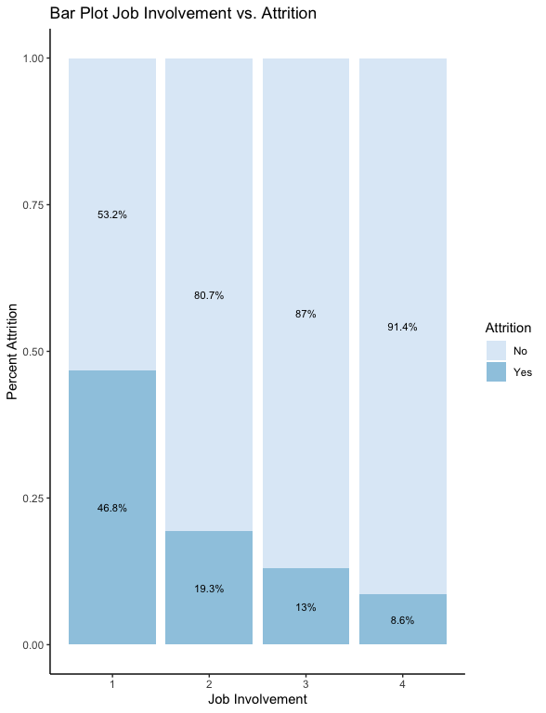
Job Involvement
On average, the employees with the higher job involvement is less likely to leave
Low – 46.8% Attrition
Medium – 19.3% Attrition
High – 13% Attrition
Very High – 8.6% Attrition
This suggests that employees that feel less involve tend to turnover more
1 - Low
2 - Medium
3 - High
4 - Very High

Slide 7
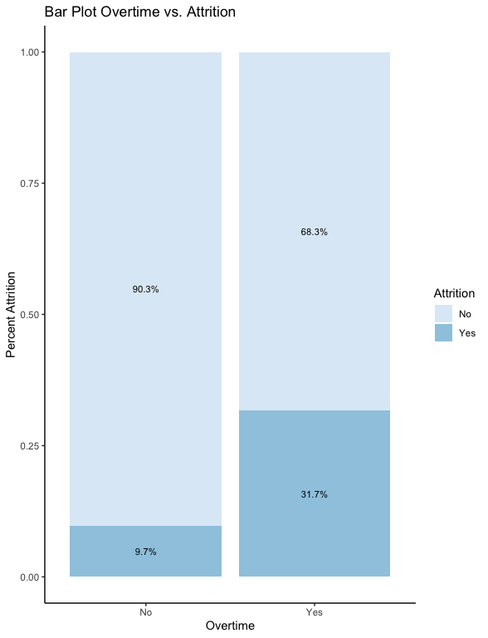
Overtime
On average, the employees that negotiable for overtime (Non-Exempt Employees) is more likely to leave
Overtime – 31.7% Attrition
No Overtime – 9.7% Attrition
This suggests that Non-Exempt Employees tend to turnover more than the Exempt Employees

Slide 8
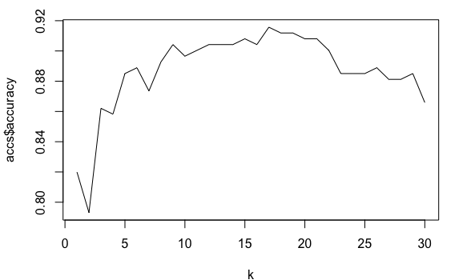
Attrition Prediction - kNN
kNN Metrics | Value
Accuracy | 86.7%
95% CI of Accuracy | (83.7%, 89.3%)
p-value | < .0001
Sensitivity | 87.7%
Specificity | 71.1%
Utilized k-Nearest Neighbor model
k = 21
Model shows statistically significant result based on p-value

Slide 9
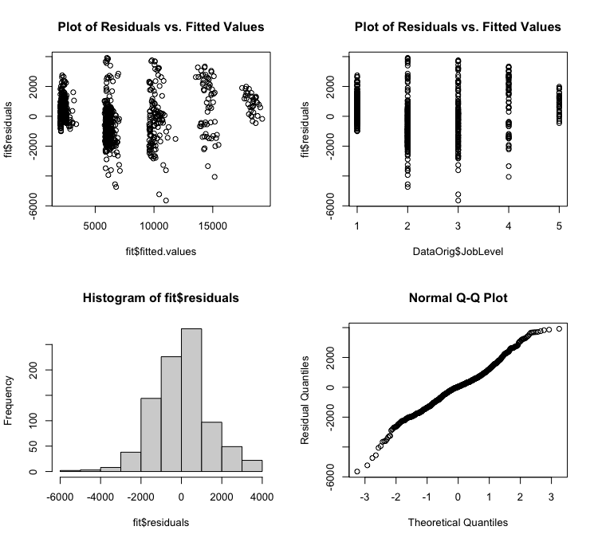
Salary Prediction - MLR
Multiple Linear Regression Model
Salary = – 1,699.16 + 3,717.24*JobLevel + 68.34*TotalWorkingYears – 59.33*YearsWithCurrManager
R² = 0.9105, Adjusted R² = 0.9102
91% of salary can be explained by job level, total working years, and years with current manager
RSME = $1,035.80

Slide 10
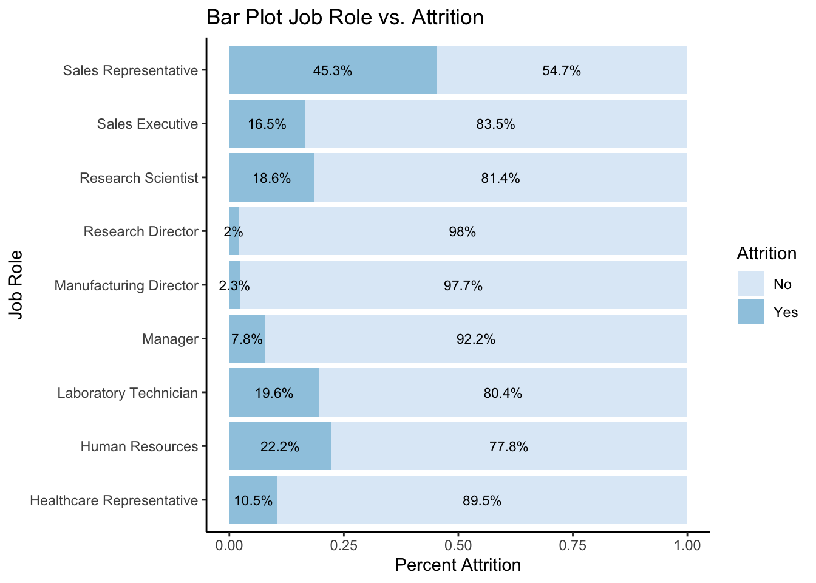
Trends by Job Role - Attrition
High percentage of attrition
Sale Representative
Human Resources
Laboratory Technician
Higher job levels, Director and Manager, have low percentage of attrition

Slide 11
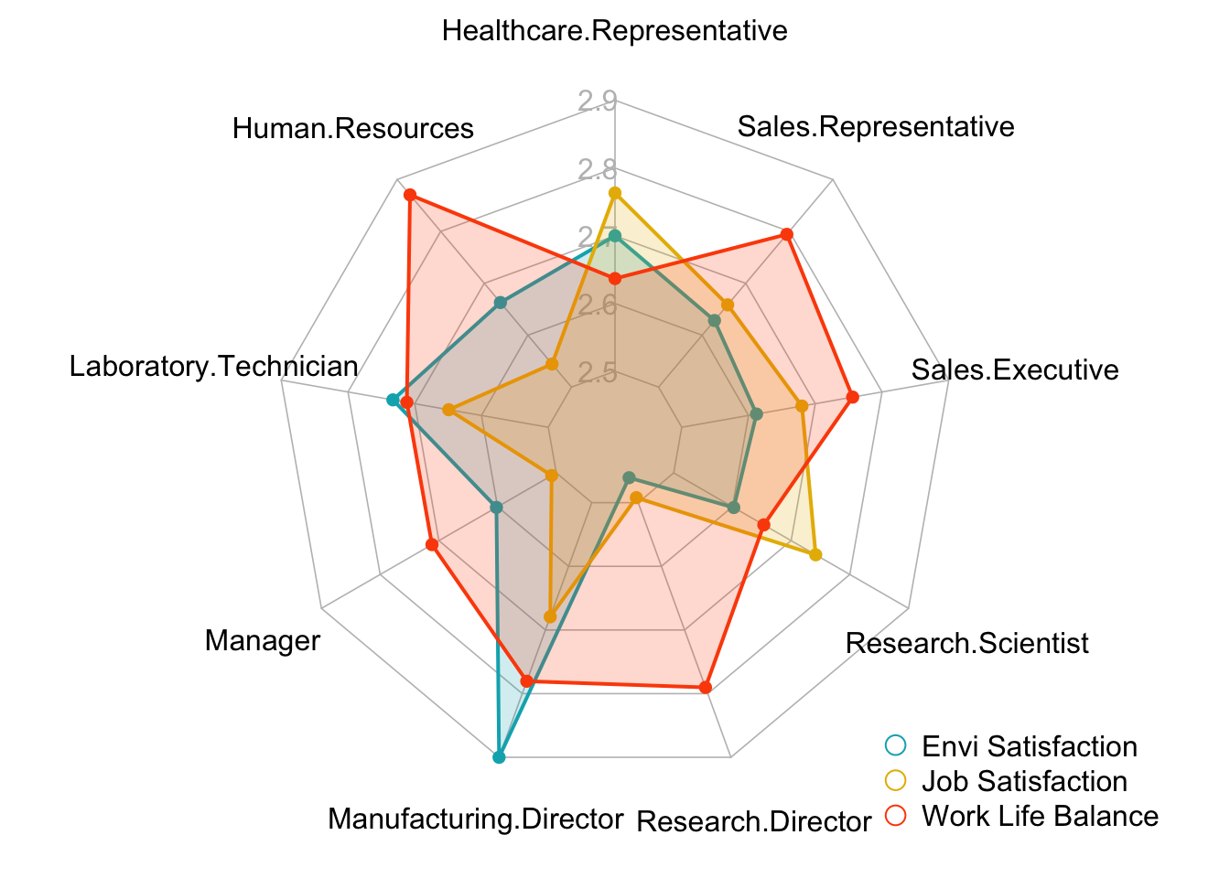
Trends by Job Role – Satisfaction and WLB
Manufacturing Directors have highest Environment Satisfaction
Healthcare Representative have highest Job Satisfaction
Human Resources have highest Work Life Balance

Slide 12
Summary
Monthly Income, Job Involvement, and Overtime
are the 3 main factors that lead to attrition
kNN Technique can be used to predict attrition with
86.7% Accuracy
87.7% Sensitivity
71.1% Specificity
Multiple Linear Regression can be used for salary prediction with
Adj R² = 91%
RSME = $1,036
Trends by Job Role
Attrition
Environment Satisfaction
Job Satisfaction
Work Life Balance
01
02
03
04

Slide 13
Thank You
Notes:
Photo by freepik

